Slide 1
Digital Business Transformation in Education: Make It a Reality
Alexander Izaguirre, PhD, MBA
EXECUTIVE PARTNER
GARTNER EXECUTIVE PROGRAMS

Slide 2
Learning Objectives
As a result of this presentation you should be able to:
Define digital business transformation.
Recognize that digital disruption can affect academia
Describe and differentiate the common approaches used by academia to engage in digital business transformation.
Compare and contrast academia’s approach to digital disruption with that of high-tech.
Be inspired to leverage your divergent thinking skills.

Slide 3
What is Digital Business Transformation
Referring to high precision and resolution data
Digital
Transformation
Business
Digital Business Transformation
Referring to a thorough or dramatic change in form or appearance
Referring to products and services that offer a value proposition to customers and support an economic model
Digital Business Transformation refers to adding a combination of digital capabilities to a company’s core product and/or service so as to derive actionable data that informs the business how to offer a better value proposition to its customers on a continuous basis.

Slide 4
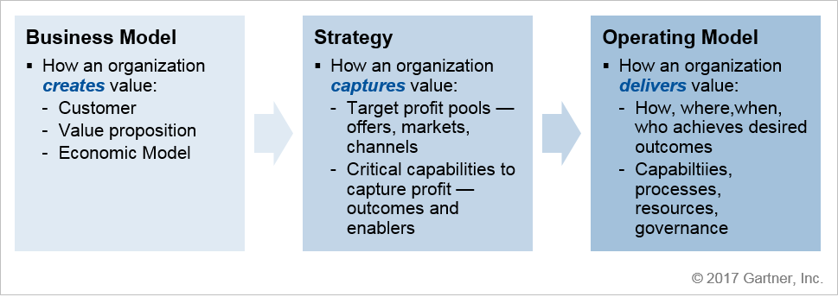
Know Your Business

Slide 5
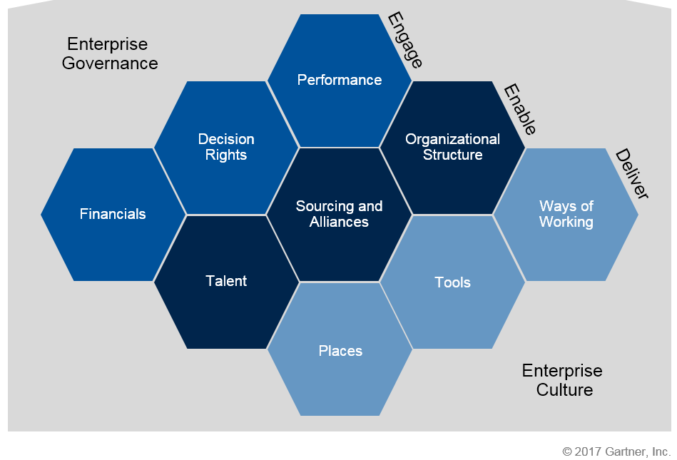

Know What to Transform

Slide 6

Know When and Where to Apply Digital
Focus your efforts on removing a customer pain point and how your organization can adjust to associated changes before considering what technology is required to effectuate change.
Digital
Transformation
Business

Slide 7

Example #1: A Thousand Songs in Your Pocket
OCTOBER 23, 2001
Apple announces
the iPod
Music is streamlined from record label to iTunes, to computer, organized and synced to iPod
Record labels agree to sell music for $0.99 a song on iTunes
Notes:
Gartner developed run-grow-transform (RGT) to support IT portfolio planning across the enterprise. Each dimension represents not only business executive expectations for the IT organization's impact on business outcomes or success, but also the focus of enterprise investment in I&T products and services. These expectations drive CIO decisions related to associated resources and capabilities and activities required to develop, manage and support those resources. Gartner uses the following RGT categories and definitions (see "Simplify Service Portfolio Prioritization and Resource Planning Using Run-Grow-Transform Categorization"):
Run the business: This is an indicator of how much of the IT resource is consumed and focused on the continuing operation of the business. Some businesses call this "business as usual," "keep the lights on" or "sustain IT" spending. Run expenses do not directly increase revenue, or achieve new or enhanced goals of the enterprise by themselves. They support or improve essential functions and deliver efficiency at the appropriate quality and price for performance.
Grow the business: This is an indicator of how much of the IT resource is consumed and focused on developing and enhancing IT systems in support of business growth (typically organic growth or improvements in known business processes). They extend existing capabilities, deliver differentiation and provide competitiveness.
Transform the business: This is an indicator of how much of the IT resource is consumed and focused on implementing information and technology I&T systems that enable the enterprise to enter new markets, address new customer segments, create new value propositions and enact new business models. This is a high-risk, high-reward category with high potential, but a naturally high failure rate.

Slide 8
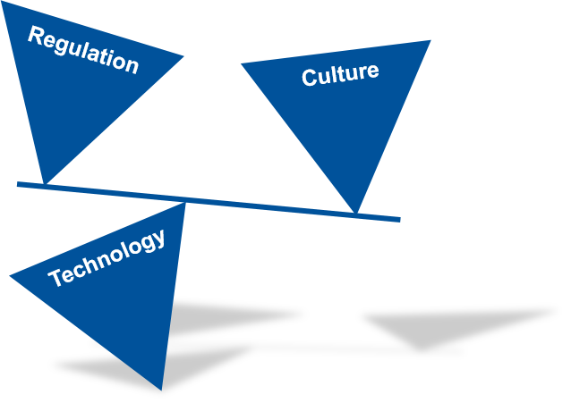


Example #2: Blurring the Lines
Notes:
Gartner developed run-grow-transform (RGT) to support IT portfolio planning across the enterprise. Each dimension represents not only business executive expectations for the IT organization's impact on business outcomes or success, but also the focus of enterprise investment in I&T products and services. These expectations drive CIO decisions related to associated resources and capabilities and activities required to develop, manage and support those resources. Gartner uses the following RGT categories and definitions (see "Simplify Service Portfolio Prioritization and Resource Planning Using Run-Grow-Transform Categorization"):
Run the business: This is an indicator of how much of the IT resource is consumed and focused on the continuing operation of the business. Some businesses call this "business as usual," "keep the lights on" or "sustain IT" spending. Run expenses do not directly increase revenue, or achieve new or enhanced goals of the enterprise by themselves. They support or improve essential functions and deliver efficiency at the appropriate quality and price for performance.
Grow the business: This is an indicator of how much of the IT resource is consumed and focused on developing and enhancing IT systems in support of business growth (typically organic growth or improvements in known business processes). They extend existing capabilities, deliver differentiation and provide competitiveness.
Transform the business: This is an indicator of how much of the IT resource is consumed and focused on implementing information and technology I&T systems that enable the enterprise to enter new markets, address new customer segments, create new value propositions and enact new business models. This is a high-risk, high-reward category with high potential, but a naturally high failure rate.

Slide 9
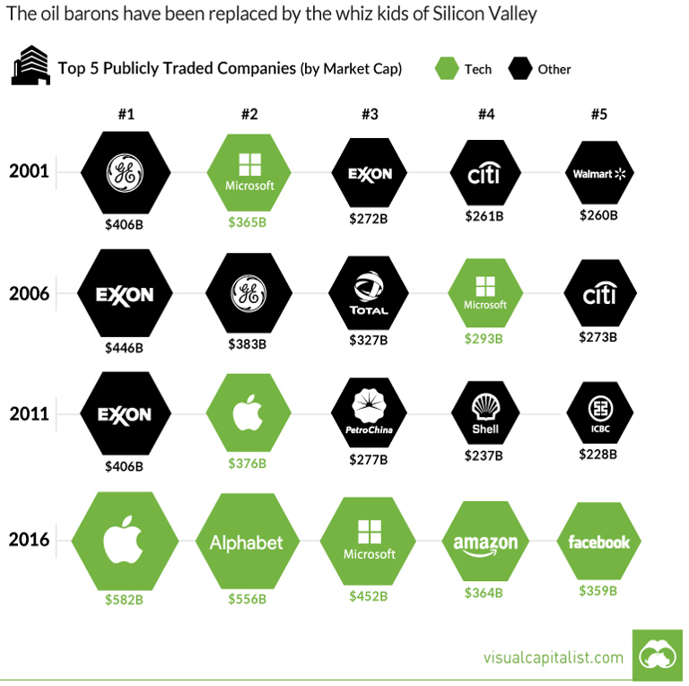
How Quickly Things Change
Where are they now? (May 3rd)
GE @ 122B (down)
Microsoft @ 736B (Up)
Exxon @ 329B (slightly up)
Citi @ 176B (down)
Walmart @ 258B (slightly up)
#67
#3
#12
#44
#18
Notes:
Gartner developed run-grow-transform (RGT) to support IT portfolio planning across the enterprise. Each dimension represents not only business executive expectations for the IT organization's impact on business outcomes or success, but also the focus of enterprise investment in I&T products and services. These expectations drive CIO decisions related to associated resources and capabilities and activities required to develop, manage and support those resources. Gartner uses the following RGT categories and definitions (see "Simplify Service Portfolio Prioritization and Resource Planning Using Run-Grow-Transform Categorization"):
Run the business: This is an indicator of how much of the IT resource is consumed and focused on the continuing operation of the business. Some businesses call this "business as usual," "keep the lights on" or "sustain IT" spending. Run expenses do not directly increase revenue, or achieve new or enhanced goals of the enterprise by themselves. They support or improve essential functions and deliver efficiency at the appropriate quality and price for performance.
Grow the business: This is an indicator of how much of the IT resource is consumed and focused on developing and enhancing IT systems in support of business growth (typically organic growth or improvements in known business processes). They extend existing capabilities, deliver differentiation and provide competitiveness.
Transform the business: This is an indicator of how much of the IT resource is consumed and focused on implementing information and technology I&T systems that enable the enterprise to enter new markets, address new customer segments, create new value propositions and enact new business models. This is a high-risk, high-reward category with high potential, but a naturally high failure rate.

Slide 10





What Do These Companies Have in Common?
Notes:
Gartner developed run-grow-transform (RGT) to support IT portfolio planning across the enterprise. Each dimension represents not only business executive expectations for the IT organization's impact on business outcomes or success, but also the focus of enterprise investment in I&T products and services. These expectations drive CIO decisions related to associated resources and capabilities and activities required to develop, manage and support those resources. Gartner uses the following RGT categories and definitions (see "Simplify Service Portfolio Prioritization and Resource Planning Using Run-Grow-Transform Categorization"):
Run the business: This is an indicator of how much of the IT resource is consumed and focused on the continuing operation of the business. Some businesses call this "business as usual," "keep the lights on" or "sustain IT" spending. Run expenses do not directly increase revenue, or achieve new or enhanced goals of the enterprise by themselves. They support or improve essential functions and deliver efficiency at the appropriate quality and price for performance.
Grow the business: This is an indicator of how much of the IT resource is consumed and focused on developing and enhancing IT systems in support of business growth (typically organic growth or improvements in known business processes). They extend existing capabilities, deliver differentiation and provide competitiveness.
Transform the business: This is an indicator of how much of the IT resource is consumed and focused on implementing information and technology I&T systems that enable the enterprise to enter new markets, address new customer segments, create new value propositions and enact new business models. This is a high-risk, high-reward category with high potential, but a naturally high failure rate.

Slide 11
Why Disrupt Education?
Higher education’s market value is estimated to be worth $1.9 Trillion, so there is plenty of money to be made, but the bigger deal is more about capturing an controlling market share.
Technology trends take root at schools and can help shape technology preferences for the future.
As young learners enter the workforce and earn incomes, they will purchase other products and services made accessible through channels controlled by Google, Apple, Amazon and Microsoft.

Slide 12

The Wiz Kids Aren’t Satisfied Playing in Their Space
Google is currently dominating the education market.
The majority of educators indicated that they would hire Google for Education to help raise student achievement, and both teachers and district officials prefer Google Chromebooks, saying the devices are inexpensive and simple to use.
According to Futuresource Consulting, 12.6 million mobile PCs and tablets were shipped to U.S. schools in 2016. Google Chromebooks made up approximately 58% of those sales.

Slide 13

The Wiz Kids Aren’t Satisfied Playing in Their Space
Microsoft, for instance, announced a bundled package of education tools and apps last year, designed to streamline the management and purchase of Microsoft products for education.
More recently, the company unveiled lower-cost devices for students, including a Lenovo 100e for $189. They’ve also integrated and updated Office 365 and introduced partnerships with LEGO Education, PBS, and NASA.

Slide 14

The Wiz Kids Aren’t Satisfied Playing in Their Space
Apple last year announced a simplified iPad designed for schools, with a lower price tag of $329. They’ve also recently introduced Classroom, an app designed to help teachers manage student learning from multiple devices.

Slide 15

The Wiz Kids Aren’t Satisfied Playing in Their Space
Amazon is newer to the education market, but the company offers a cloud-based storage, data, and analytics system through its Amazon Web Services. Many school systems are adopting the system to replace physical storage.
Amazon also plans to create a platform for open educational resources, and they’ve announced a tool called TenMarks writing, which includes writing exercises, a digital assistant that personalizes feedback to students, and lesson plans and assignments for teachers. The program costs $4 per student.

Slide 16
Could High Tech Impact Business Trends in Education?
Reinventing Credentials
Analytics Everywhere
Personalization in Education
Ranking
Ecosystem
Ethical Use of Data
Revenue Diversification
Competency-Based Education
Mergers and Acquisitions
Maturing Online Learning

Slide 17
Top 10 Strategic Technologies Impacting Higher Education
Digital Credentials
Predictive Analytics
Nudge Tech
Next-Generation Security
Virtual Reality (VR)/Augmented Reality (AR) Comeback
Hybrid Integration Platforms
Digital Assessment
Blockchain
Next-Generation SIS
AI Conversational Interface

Slide 18
Academia’s Approaches to Digital: Strategic Plan
Approach: Add technology need to the strategic plan.
Intent: Digitalization will increase by focusing an importance on the need to leverage digital technology in the strategic plan.
Unintended consequence: Technology expenditures are approved without an understanding of what real strategic value is being created. Typically, operational efficiencies drive investment justifications.
Fundamental flaw: Strategic planning should be focused on what is required to optimize the value proposition of products and services and increasing customers, while technology is simply an enabler to executing the strategy. Strategic plan cycles run 3 – 5 years while technology changes constantly.

Slide 19
Academia’s Approaches to Digital: Buy More Tech
Approach: Introduce/Upgrade/Update technology.
Intent: Digitalization will increase by introducing or upgrading the student learning system, collaboration tools, ERP, etc.
Unintended consequence: Huge investments are made yet little strategic value is realized.
Fundamental flaw: You may further digitize your environment through adoption of technology, but that does mean you have increased digitalization of your environment. What about the business has changed?

Slide 20
Academia’s Approaches to Digital: Charge the CIO
Approach: Make digital transformation/innovation the job of the CIO.
Intent: Digitalization will increase by having the office of the CIO identify and introduce new digital technology initiatives.
Unintended consequence: The CIO attempts introduce emerging technologies in an environment that is resource constrained and is chastised for allocating resource on “nice to have” projects.
Fundamental flaw: Digital business transformation must be an institutional effort not the responsibility of one operational department (IT). Moreover, traditional IT leaders tend to demonstrate a stronger acumen to operational IT vs. innovation.

Slide 21
Academia’s Approaches to Digital: Innovation Leaders
Approach: Hire an innovation leader.
Intent: Digitalization will increase by bringing an expert that can evaluate emerging technologies and drive the adoption of them.
Unintended consequence: The Innovation leaders find themselves struggling to gain consensus and financial support to move an significant opportunity forward.
Fundamental flaw: Innovation leaders are rarely provided staff or budget to execute a full “digital strategy”. They lack the authority, and a times the knowledge, necessary to lead business strategy sessions and gain c-suite consensus around system wide initiatives that require; funding, access to subject matter experts, dedicated staff, institutional alignment and more.

Slide 22
Academia’s Approaches to Digital: Innovation Centers
Approach: Develop partnerships with innovation centers.
Intent: Digitalization will increase by working with innovation centers and gaining access to entrepreneurs that are developing cutting edge technology.
Unintended consequence: Many of the technologies that are developed are either too transformative or underdeveloped for academic institutions to introduce in to their highly risk averse environments.
Fundamental flaw: Startup open to risk as they are small and have little to lose, while established institutions or those are government sponsored are highly risk averse. Also, the sales cycles at academic institutions can go as far as 18 months. Most start ups struggle to ever close a deal with academic organizations.

Slide 23
So How Does High Tech Do Digital?
Digital Disruption
Identify a Market
Identify Customer Pain Points
Define the value proposition
Create a Digital Solution

Slide 24

Visioning and a Willingness to Explore
Explore how you can change your business strategy and disrupt your own industry. Then explore how digital technology can help you better execute.

Slide 25
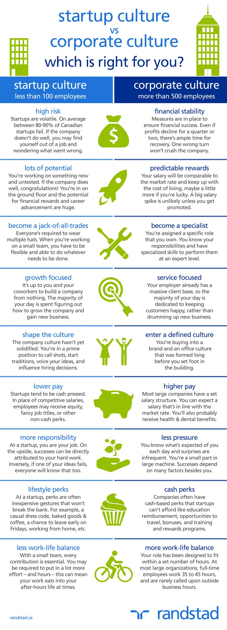
Create a Safe Culture/Environment to Innovate

Slide 26
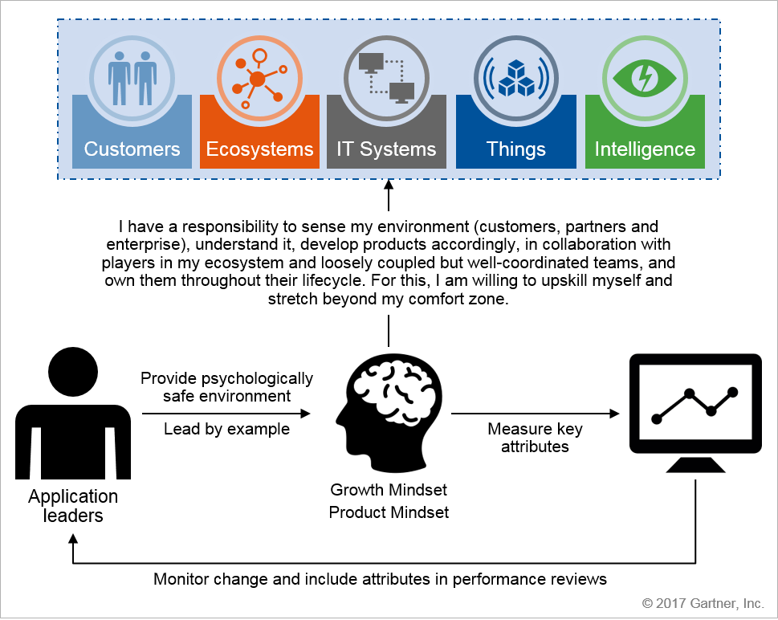
What Capabilities are Required to Go Digital

Slide 27
Customer Experience
(CX) encompasses all the interactions a person has with your brand. It might be measured in: overall experience, likelihood to continue use, and likelihood to recommend to others. CX seeks to optimize Satisfaction, Loyalty and Advocacy.
Notes:
A digital business technology platform is the combination of technologies that enables platform business models. Digital platforms share assets such as data, algorithms and transactions (both monetary and nonmonetary) with business ecosystems to match, create and exchange services.

Slide 28
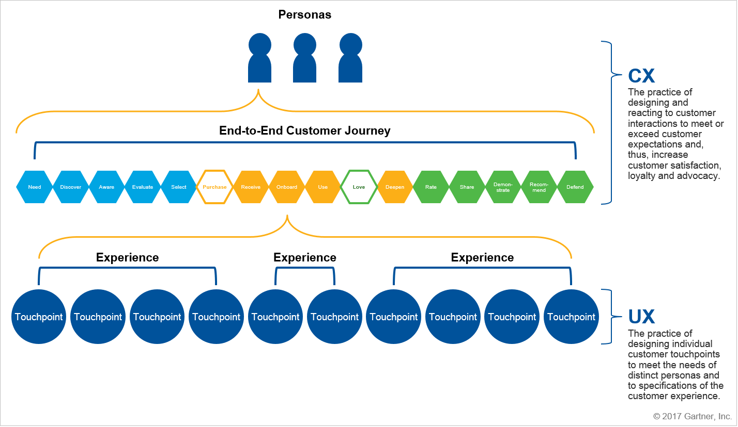
Know Your Customers
Notes:
A traditional "pipeline" organization creates value for its customers from the inside-out; a platform business enables business ecosystems to co-create value with or for the organization from the outside-in (potentially multiplying value creation).

Slide 29
Ecosystems
Are your assets, such as data, algorithms, transactions and business processes, available through APIs to external ecosystem? Can we leverage our existing electronic data interchange (EDI)-based B2B integration infrastructure?
Notes:
A digital business technology platform is the combination of technologies that enables platform business models. Digital platforms share assets such as data, algorithms and transactions (both monetary and nonmonetary) with business ecosystems to match, create and exchange services.

Slide 30
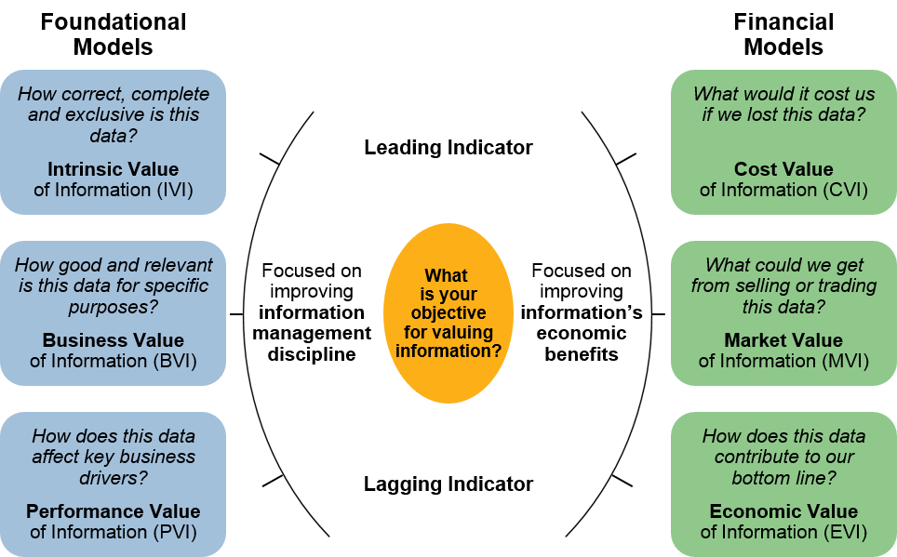
Define How The Business Seeks to Leverage Data

Slide 31
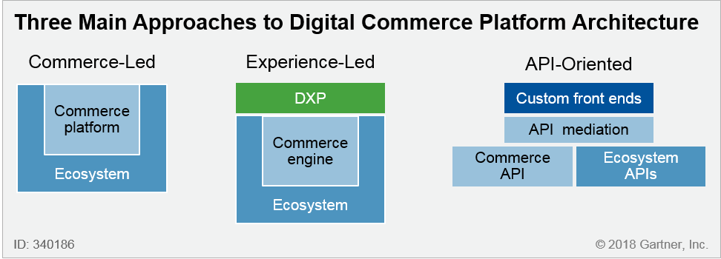
What Approach is Most Relevant for Your Company?

Slide 32
IT Systems
How do we leverage and extend our existing IT systems and build new capabilities to support our digital business initiatives without impacting on our physical business models? Which applications should we rehost, refactor and/or replace?
Notes:
A digital business technology platform is the combination of technologies that enables platform business models. Digital platforms share assets such as data, algorithms and transactions (both monetary and nonmonetary) with business ecosystems to match, create and exchange services.

Slide 33
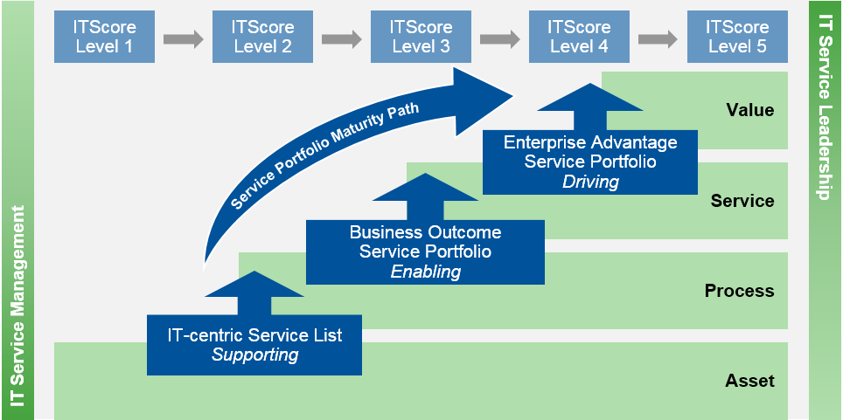
Let Value Drive Your Operating Model
Notes:
A digital business technology platform is the combination of technologies that enables platform business models. Digital platforms share assets such as data, algorithms and transactions (both monetary and nonmonetary) with business ecosystems to match, create and exchange services.

Slide 34
Things
Do you have a platform to connect with enterprise, customer and partner-owned things? Which Internet of Things platforms should we evaluate?
Notes:
A digital business technology platform is the combination of technologies that enables platform business models. Digital platforms share assets such as data, algorithms and transactions (both monetary and nonmonetary) with business ecosystems to match, create and exchange services.

Slide 35
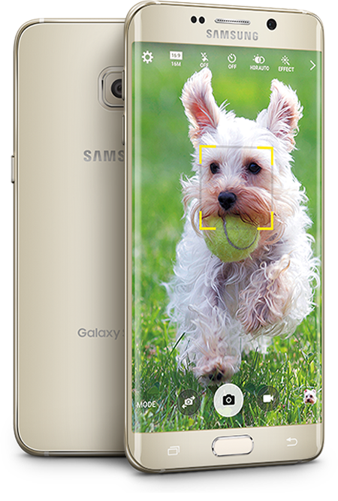

How Many Sensors on the Samsung Galaxy S6 Edge?
Accelerometer
Barometer
Fingerprint sensor
Gyro Sensor
Geomagnetic Sensor
Hall Sensor
Heart Rate Sensor
Light Sensor
Proximity Sensor

Slide 36
From Desktop to Mobile to Wearables
Audio and video
Medical and safety
Clothing
Jewelry/Accessories
Hands
Carryable or pocketable
Quantified self
Pets
Feet
Notes:
SPA: By 2020, over 35% of the population in mature markets will own at least one wearable electronic device
We think Apple and Google platforms will have good penetration in this space, but will also spawn some new, proprietary platforms
Recently an award from Federal government to a consortium of companies to make smart fabrics – embed technology into clothing. Driven by military but will have civilian applications as well.
Challenges: privacy, security, standardization, device lock-in
Medical and safety
Audio and visual aids, Cycle helmet, Medical sensors, Smart prosthetics
Clothing
Fashion, Sports and fitness, Safety clothing, Sartorial robotics
Hands
Sensor gloves, Rings, Finger sensors, Fingernail displays, Smart fingernails
Pets
Pet fitness, Tracking, Pet toys, Remote control
Feet
Shoes, Insoles
Quantified self
Fitness bands, Biosensors, Subcutaneous sensors
Carryable or pocketable
Bags, Tags, E-cigarettes, Selfie drones
Jewelry/Accessories
Watches, Belts, Pendants, Tags/Trackers, Smart wig
Audio and Video
Headsets, Glasses, Contact lenses
Major Challenges
Low entry barriers with many innovations … short life span … many failures
Vendor and Standards battles … Fragmentation of devices/vendors/expiences/APIs … Services battleground
Usability and battery life … slave devices and platgform lock-in
It’s a fashion business …. New devices require new habits (and drive new habits) …
What to Expect
What to do

Slide 37
Intelligence
Do we have information management and analytical capabilities? How can you capture, analyze and use information and events in real time to identify business moments and make better decisions? Which data and analytics tools and staff do we need?
Notes:
A digital business technology platform is the combination of technologies that enables platform business models. Digital platforms share assets such as data, algorithms and transactions (both monetary and nonmonetary) with business ecosystems to match, create and exchange services.

Slide 38
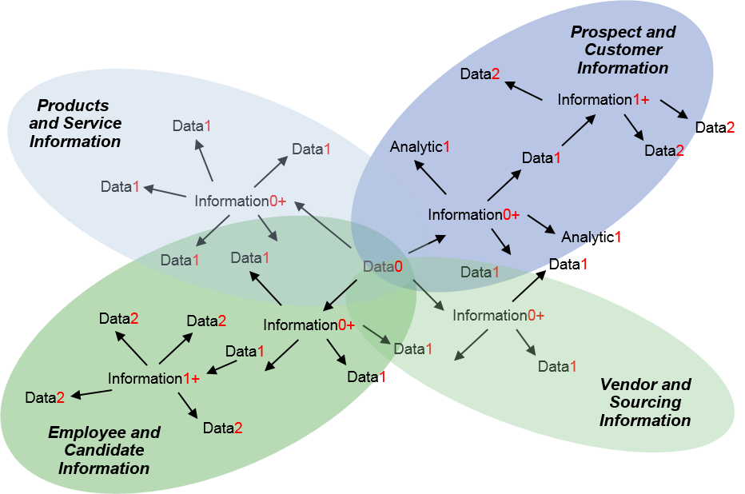
Information Mesh
Notes:
A digital business technology platform is the combination of technologies that enables platform business models. Digital platforms share assets such as data, algorithms and transactions (both monetary and nonmonetary) with business ecosystems to match, create and exchange services.

Slide 39
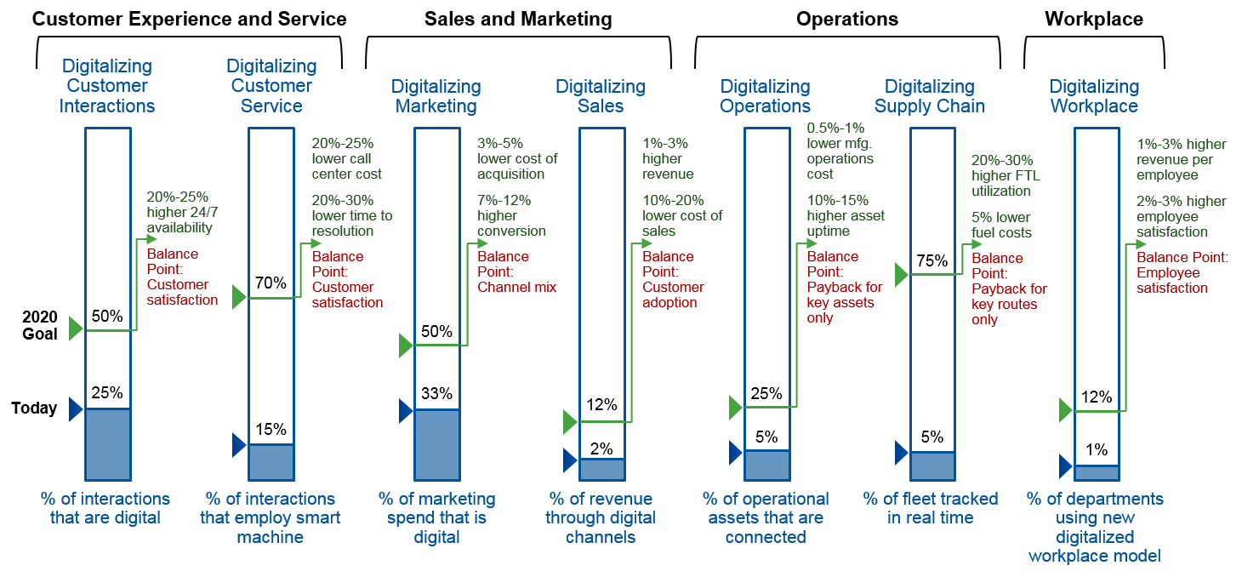
What are Your Key Performance Indicators?

Slide 40
Demonstrate Value Objectively?
Outcomes
What will we achieve as a result of investing in this initiative?
Measure
What measure(s) inform us that our initiative is supporting our desired outcome(s)?
Method
What method(s) or metrics do we use to measure?
Owner
Who is the owner responsible for delivering the metric(s)?

Slide 41

Give Your Ideas Time to Grow

